Slide 1
Tesla
Made by: Chernyavskiy O.V.
June 2021

Slide 2
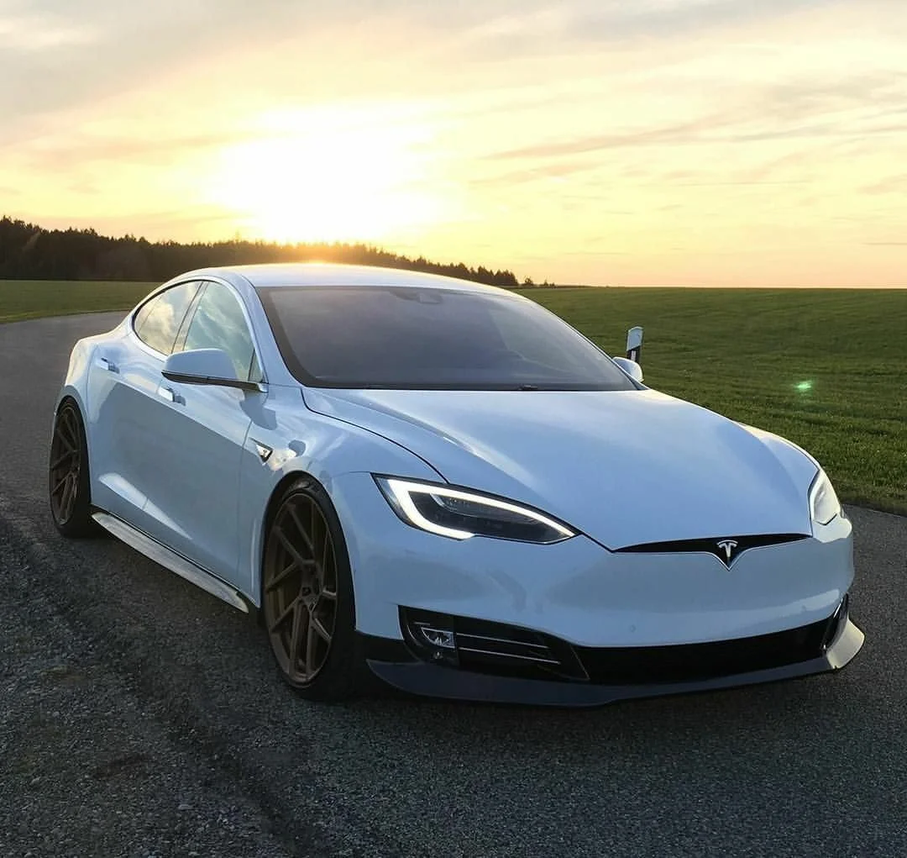
Tesla (formerly Tesla Motors) is an American company, manufacturer of electric vehicles and (through its subsidiary SolarCity) electric energy storage solutions. The company was founded in July 2003 by Martin Eberhard and Mark Tarpenning, but the current management of the company is called the co-founders of Elon Musk, Jeffrey Brian Straubel and Ian Wright. It is named after the world-famous electrical engineer and physicist Nikola Tesla.

Slide 3
Переведите текст
On May 7, 2016, while driving on US 27a near Williston, Florida, USA, a Tesla S collided with a semi-trailer towing a tractor. The tractor was turning left when the car dived under the semi-trailer at full speed, and its roof was blown off. Next, the car went off the road and rolled over three times. The driver, 40-year-old Joshua Brown, was killed. According to the company Tesla, at the time of the collision, the car was moving on autopilot, but neither the automation nor the driver started braking. This is the first ever case of death of a driver behind the wheel of a car driven by autopilot. The National Highway Traffic Safety Administration has launched its own investigation into the accident. The investigation was completed in January 2017, the conclusion states that the autopilot of the Tesla car was serviceable and worked in full accordance with the specified algorithm. Further explanations follow. A 2007-2011 study of automatic braking systems showed that they do not respond adequately to objects moving rapidly in the transverse direction. Therefore, it was recommended to exclude this scenario from the algorithm of the system. For the 2016 model year, no car or component manufacturer has announced a system for tracking transversely moving objects. Thorough tests of the Tesla Model S 85D car, conducted after the accident, showed that the autopilot of the car responds perfectly to parallel moving cars, front and side, including maneuvering ones. The system does not provide a reaction to a transversely moving object, as happened in the accident in Florida

Slide 4
Составьте предложения
American company
Full Self-Driving system
Robotaxi
Superchargers
New machines

Slide 5
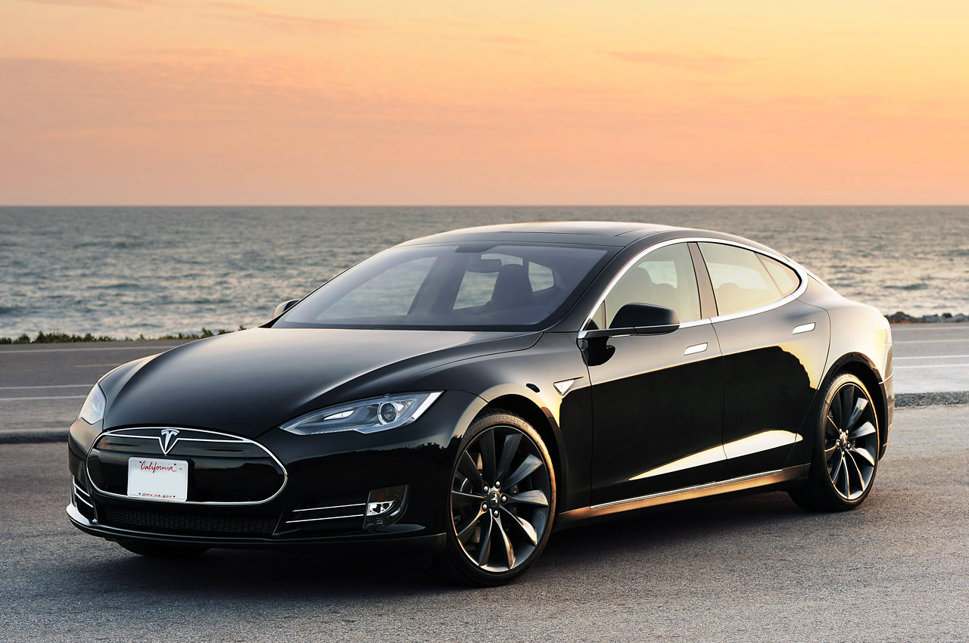
Plans
In 2020, Elon Musk tweeted that the new Robotaxi service is ready for use this year. The innovation applies to all Tesla models and is a fleet of fully autonomous taxis. Robotic electric cars will be able to transport passengers without involving a driver thanks to the "smart" Full Self-Driving system. You can manage them using the mobile app. Thus, a car-sharing system will be created: when the owner of an electric car will be able to rent out his car at a distance. The profit from such trips will be divided between the owner of the car and the company. At the moment, the system is fully ready and functioning (according to Musk). The implementation date of the Robotaxi project depends only on the approval of regulatory authorities and the issuance of a level 5 autonomous driving permit. On May 11, 2021, it was announced that the company had abandoned plans to purchase land in Shanghai to expand its factory in that city.

Slide 6
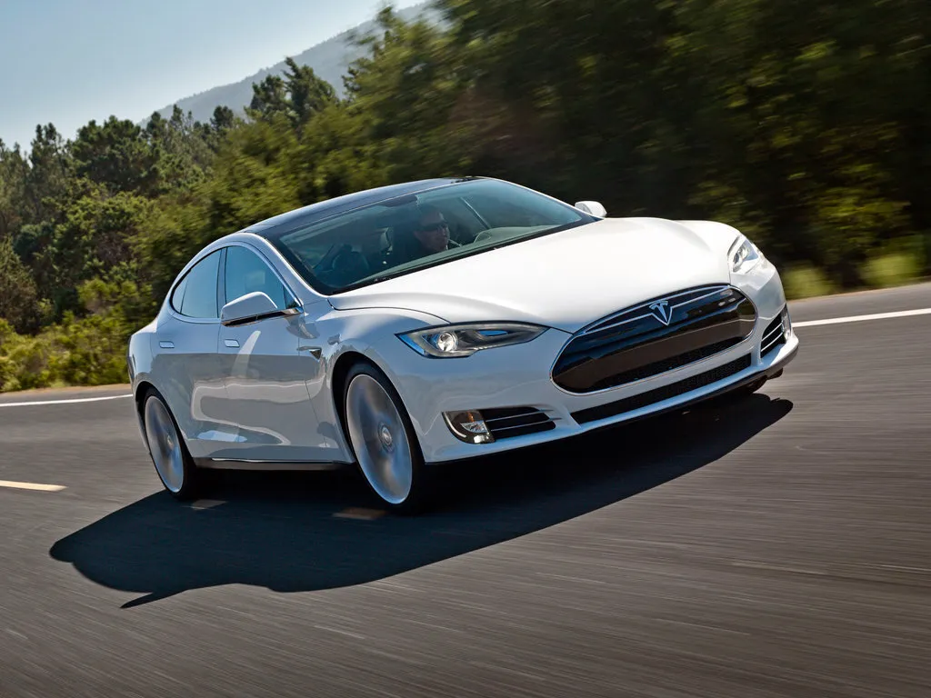
Production facilities
The company is currently conducting a large-scale assembly of the Tesla Model S in the Netherlands. In an interview with Bloomberg, Elon Musk spoke about plans to expand the production of Tesla cars in Europe — the deployment of mass production in Europe is planned to begin with the launch of the "budget" version of the Tesla Model 3.The second foreign Tesla plant will appear in Germany. On February 13, 2020, Tesla began preparations for the construction of its first European plant for the production of electric vehicles. Despite the complaints and protests of local environmentalists, the court allowed the automaker to cut down the forest on the site of future construction: the company is planned to be built on a plot of coniferous forest near Berlin. On February 21, a court in Germany recognized the validity of the construction of the plant despite the claim of local environmental activists. The company expects to start production at the plant under construction by July 2021. At the first stages, the company must establish the assembly of the Tesla Model Y crossovers for the European market (according to their specifications, they may differ markedly from those produced in China or the United States)

Slide 7
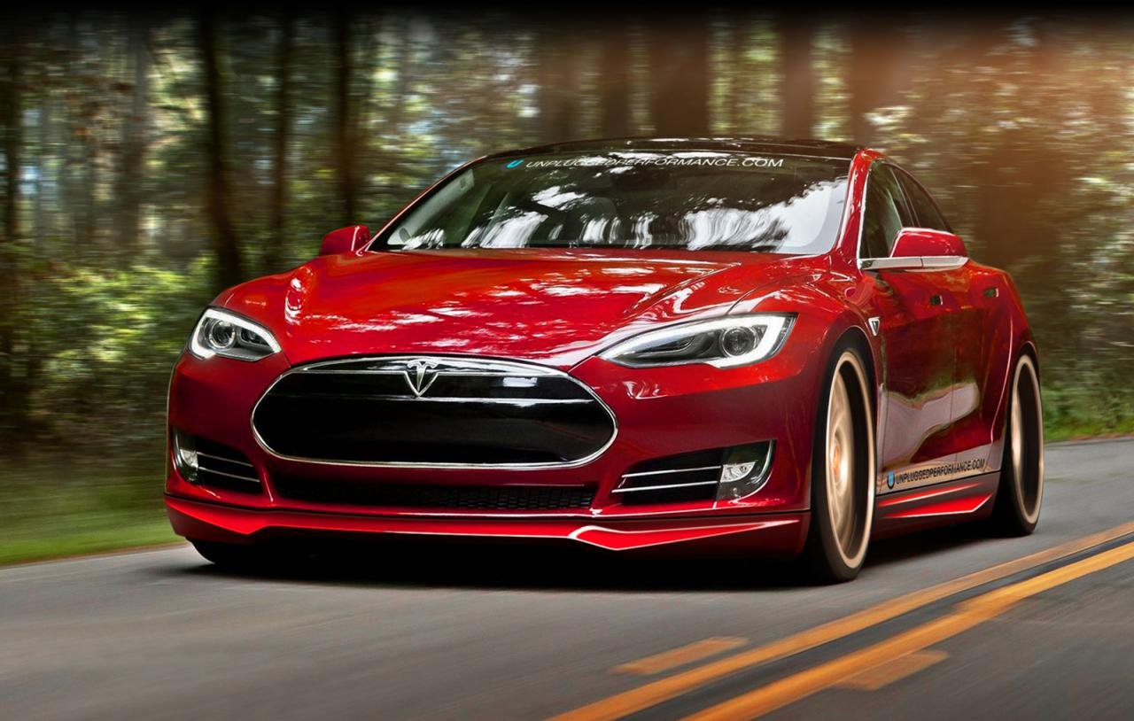
Supercharger
Tesla is deploying a network of" Superchargers " (Eng. Supercharger) — stations for charging electric vehicles, designed to allow Tesla cars to make long trips. Some stations use energy from solar panels (in the future, it is planned to transfer all stations to the use of solar energy, as of 2018, there are only 3 such stations). The ability to use stations is available in all new machines, but some older 60 kWh models require the purchase of an additional module for $ 2,500.

Slide 8
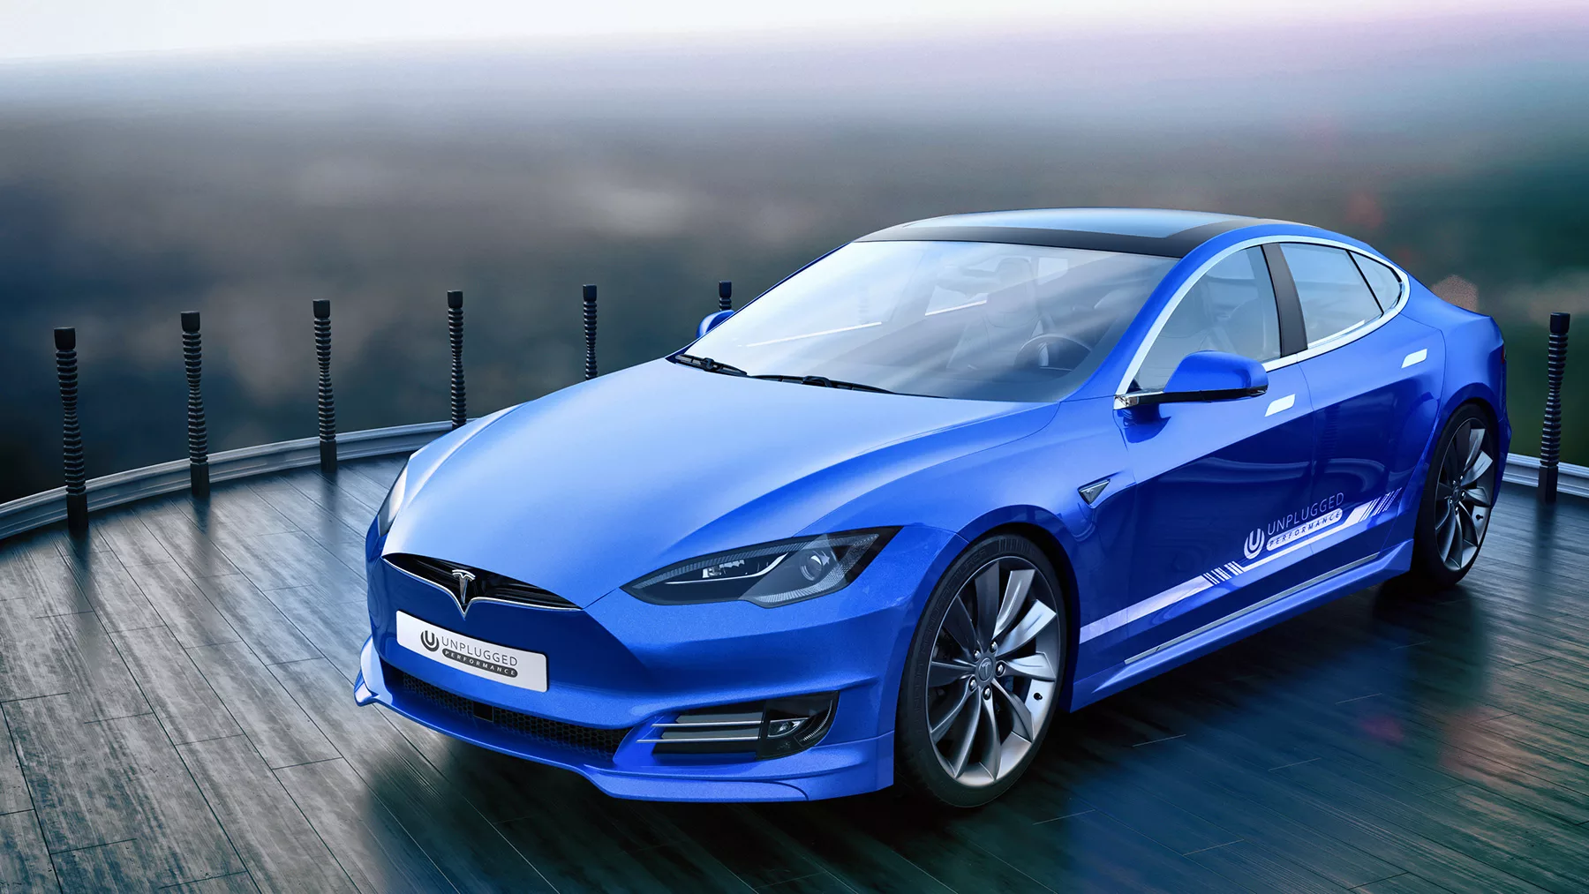
Business model
Unlike most automakers, Tesla does not sell cars through independent dealers. As a rule, Tesla showrooms are only demonstration sites, the purchase is made directly through the Tesla website. This is somewhat similar to Apple's sales model. In most US states, direct sales of cars from manufacturers and sales through their own dealers are restricted or prohibited. Tesla had to face lawsuits to ban direct sales. In some states (Virginia, Texas), the company lost cases, and sales of Tesla were banned.

Slide 9
Переведите текст
On May 7, 2016, while driving on US 27a near Williston, Florida, USA, a Tesla S collided with a semi-trailer towing a tractor. The tractor was turning left when the car dived under the semi-trailer at full speed, and its roof was blown off. Next, the car went off the road and rolled over three times. The driver, 40-year-old Joshua Brown, was killed. According to the company Tesla, at the time of the collision, the car was moving on autopilot, but neither the automation nor the driver started braking. This is the first ever case of death of a driver behind the wheel of a car driven by autopilot. The National Highway Traffic Safety Administration has launched its own investigation into the accident. The investigation was completed in January 2017, the conclusion states that the autopilot of the Tesla car was serviceable and worked in full accordance with the specified algorithm. Further explanations follow. A 2007-2011 study of automatic braking systems showed that they do not respond adequately to objects moving rapidly in the transverse direction. Therefore, it was recommended to exclude this scenario from the algorithm of the system. For the 2016 model year, no car or component manufacturer has announced a system for tracking transversely moving objects. Thorough tests of the Tesla Model S 85D car, conducted after the accident, showed that the autopilot of the car responds perfectly to parallel moving cars, front and side, including maneuvering ones. The system does not provide a reaction to a transversely moving object, as happened in the accident in Florida

Slide 10
Составьте предложения
American company
Full Self-Driving system
Robotaxi
Superchargers
New machines

Slide 11
Домашнее задание
Написать текст на тему: «Автомобиль Tesla Cybertruck и его характеристики»

Slide 12
Thank you for your attention

