Slide 1
Sukhoi Superjet 100
Выполнил:
Чернявский О.В.
Май 2021
Троицк 2021

Slide 2
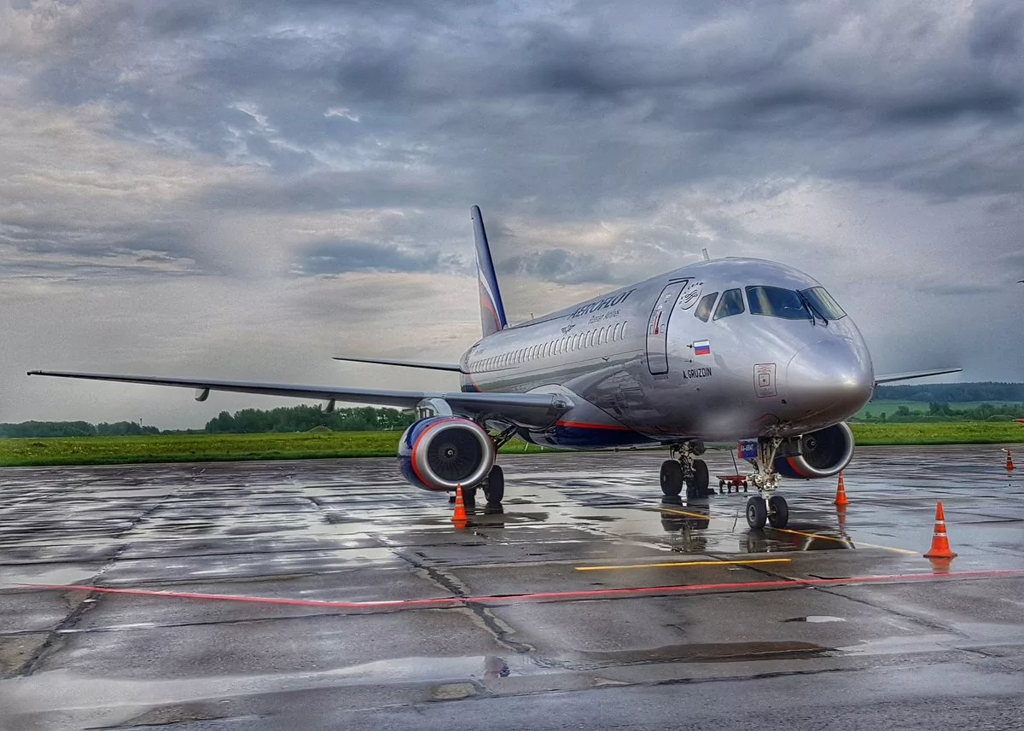
brief information
Russian short-haul narrow-body passenger aircraft, designed to carry from 87 to 108 passengers at a range of 3050 or 4600 km. Developed by Sukhoi Civil Aircraft with the participation of a number of foreign companies (see below). The first passenger aircraft developed in Russia after the collapse of the USSR. Designed only with the use of digital technologies

Slide 3
Переведите текст
On February 20, 2008, in preparation for the first flight, the first race of SaM146 engines was successfully conducted in Komsomolsk-on-Amur on the SSJ 100 flight copy (No. 95001). On May 14, tests were conducted on the runway: taxiing and jogging of the aircraft were practiced (acceleration on the runway to 162 km / h). On May 19, 2008, the first flight copy made its first flight. On November 2, SSJ 100 (s / n 95006) was delivered from Komsomolsk-on-Amur to the Chaplygin Siberian Research Institute of Aviation for resource testing. On December 24, the second flight copy flew into the sky under the control of test pilots Leonid Chikunov and Nikolai Pushenko. The plane spent two and a half hours in the air with a flight altitude of up to six thousand meters.

Slide 4
SSJ-75
In April 2018, representatives of the SCAC announced the development of a shortened version of the SSJ-75 with a capacity of 75 seats until 2022. The creation of the SSJ75 can be considered an upgrade of the aircraft with the use of new domestic technologies and components, such as the PD-14 engine family and a new wing made of composite materials. The upgraded and redesigned aircraft should receive several versions in terms of capacity. The modernization of the aircraft will solve the problems of import substitution, problems of system reliability and maintenance of airworthiness.

Slide 5
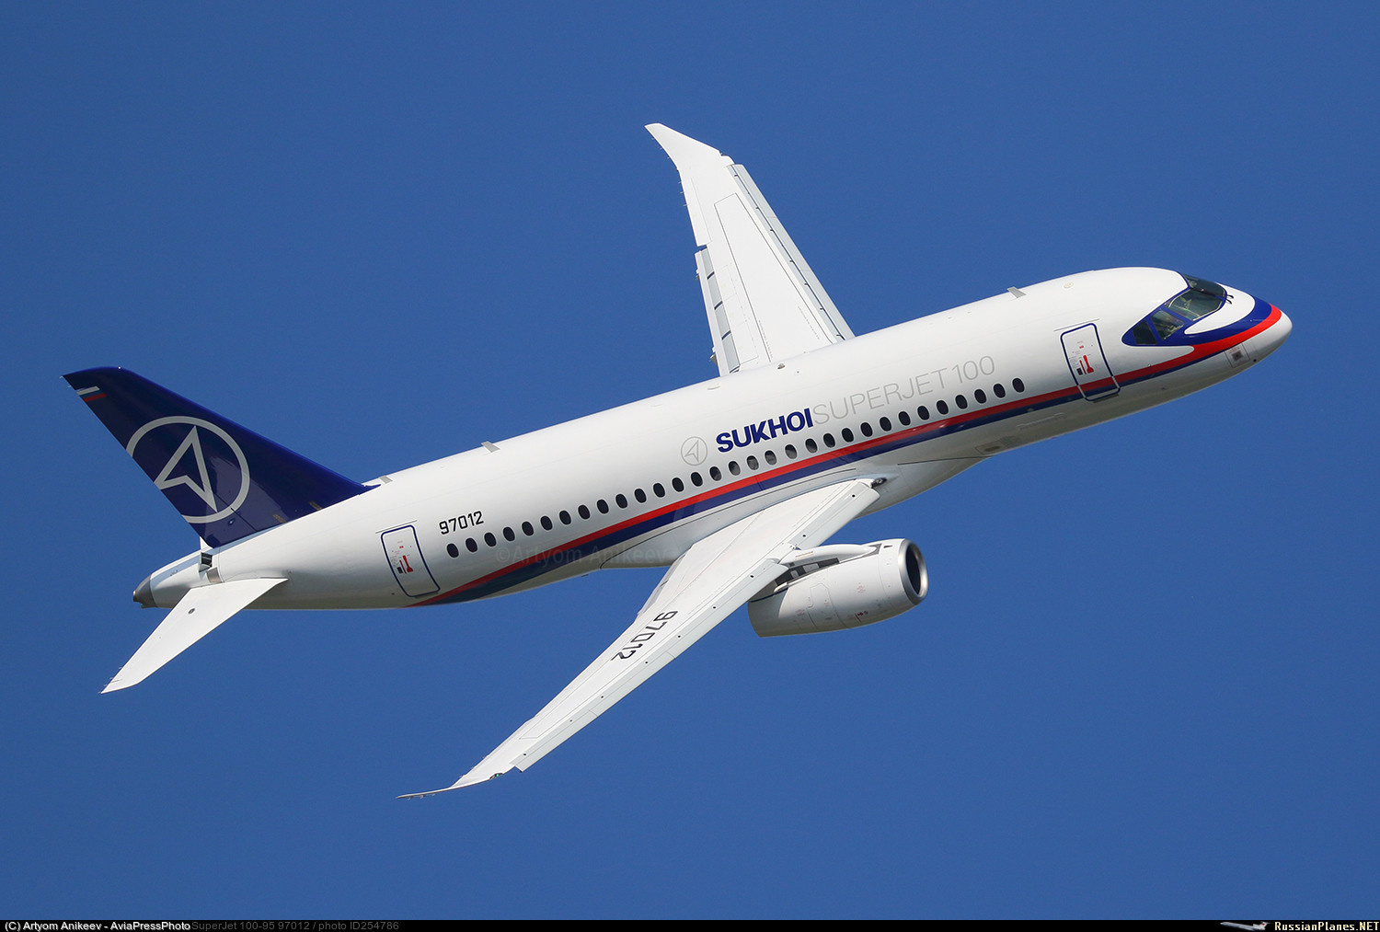
Sukhoi Superjet New
In April 2018, it was announced the creation of the Sukhoi Superjet 100R (SSJ100R) model, in which the share of Russian components will be increased by 10-15 %. In April 2019, a plan was announced to revise the program in favor of maximum import substitution of components and systems, called SSJ-New (RRJ-95NEW-100), instead of SSJ100R. In 2019, the Voronezh "Experimental Design Bureau of Motor Engineering" (OKBM) completed the preliminary design of the wing mechanization control system. In 2020-2022, it is planned to complete the development of the components of the integrated management system. In July 2020, flight tests of the BINS-2015 inertial navigation system developed by the Moscow Institute of Electromechanics and Automation began. The inertial navigation system currently being developed (2020) at KRET should be completed by 2021, after which its testing will begin, and the system's certification is scheduled for 2022.

Slide 6
Составьте предложения
Modernization
Upgrade
Designed
Sky
Management system
Navigation system

Slide 7
Домашнее задание
Составить текст на тему: «перспективы развития Российского авиастроения»

Slide 8
Thank you for your attention!

