Slide 1
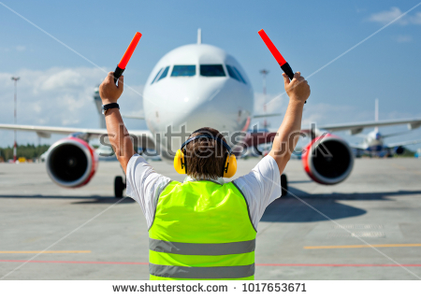
Наземный экипаж
Троицкий авиационный технический колледж ГА
Выполнил: Чернявский О.В.
Троицк, январь 2019

Slide 2
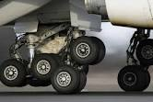
Цель занятия:
1.
Изучение состава наземного экипажа.
Задачи:
1.
Изучить состава наземного экипажа,
Знать предназначение и рассказывать о нем на английском.
Закрепить полученный материал на
практике
2.
3.

Slide 3
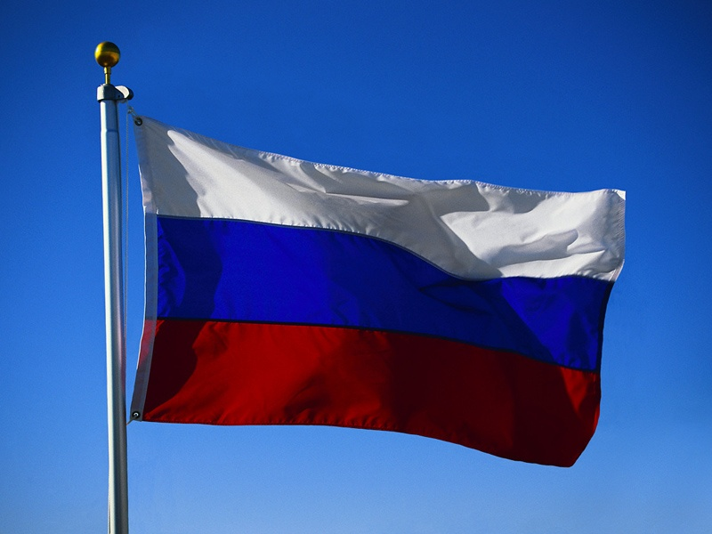
In aviation, groundcrew or ground staff are the support personnel that service aircraft on the ground – as opposed to aircrew, who operate an aircraft while in flight. The term groundcrew is used by both airlines and military aviation.
Airline ground crew members include: airframe and power plant technicians, avionics technicians, ramp agents, customer service agents, and flight dispatchers. Ground crew members are responsible for clearing the runway and gate area of any debris or garbage, in order to prevent foreign object damage by an object being sucked into an engine. The crew visually inspects the tarmac and removes any items found; this is typically called a "FOD walk" and is done prior to an aircraft's arrival and departure.

Slide 4
An Aircraft Maintenance Engineer (AME), also Licensed Aircraft Maintenance Engineer (LAME or L-AME), is a licensed person who carries out and certifies aircraft maintenance. The license is widespread internationally and is recognized by the International Civil Aviation Organization (ICAO). The American FAA recognize the qualification in foreign countries but refer to it as Aviation Maintenance Engineer rather than "Aircraft...". Countries which issue or recognize AME licenses internally include; Australia, Bangladesh, Canada, India, New Zealand, the United Kingdom and much of Asia. The American equivalent of an AME is an aircraft maintenance technician (AMT), also known as an A&P.
Up until 1998, Type I and Type II Aircraft Maintenance Engineer (AME) licenses were distinguished. In 1998 ICAO replaced these by a single AME license.
In 2005 the relationship between the Canadian AME and the US A&P (AMT) was further revised, through a Bilateral Aviation Safety Agreement (BASA) between the US and Canada.

Slide 5
Переведите и выучи предложения наизусть
Ground crew is an airport personnel as opposed to those who work on board aircraft. (in British)
Ground crew is a team of people who maintain and repair aircraft. (in American)
At an airport, the people who look after the planes when they are on the ground are called the ground crew.

Slide 6
Переведи, запиши новые слова.
Ground Support Equipment (GSE) is the support equipment found at an airport, usually on the apron, the servicing area by the terminal. This equipment is used to service the aircraft between flights. As the name suggests, ground support equipment is there to support the operations of aircraft whilst on the ground. The role of this equipment generally involves ground power operations, aircraft mobility, and cargo/passenger loading operations.

Slide 7
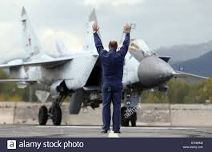
Перескажи
Countries which issue or recognize AME licenses internally include; Australia, Bangladesh, Canada, India, New Zealand, the United Kingdom and much of Asia.^{[3][4][5][6]}
The American equivalent of an AME is an aircraft maintenance technician (AMT), also known as an A&P.
Up until 1998, Type I and Type II Aircraft Maintenance Engineer (AME) licences were distinguished. In 1998 ICAO replaced these by a single AME licence.
In 2005 the relationship between the Canadian AME and the US A&P (AMT) was further revised, through a Bilateral Aviation Safety Agreement (BASA) between the US and Canada.

Slide 8
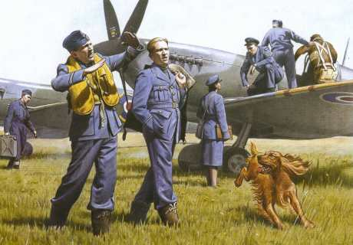
К данному тексту составь по пять вопросов и запиши их
An Aircraft Maintenance Engineer (AME), also Licensed Aircraft Maintenance Engineer (LAME or L-AME), is a licensed person who carries out and certifies aircraft maintenance. The license is widespread internationally and is recognised by the International Civil Aviation Organization (ICAO). The American FAA recognise the qualification in foreign countries but refer to it as Aviation Maintenance Engineer rather than "Aircraft...".

Slide 9
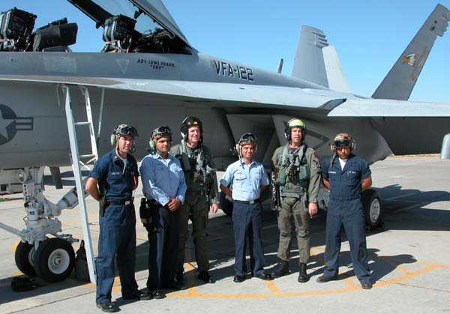
Опиши на английском кто изображен на рисунке

Slide 10
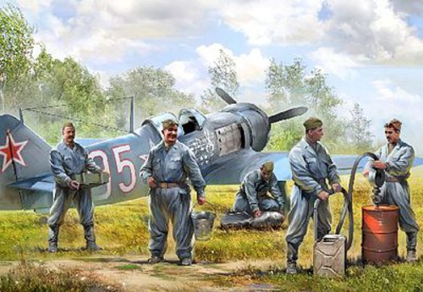
Составь рассказ по рисунку

Slide 11
Ответь на английском сегодня :
Наземный экипаж - это…
Наземное оборудование - это …
Обслужить самолёт значит -...
Буксировка - это…
При заправке необходимо - …

Slide 12
Источники:
http://avia.pro/plane_fuselage
https://www.nasa.gov/index.html
https://en.wikipedia.org

