Slide 1
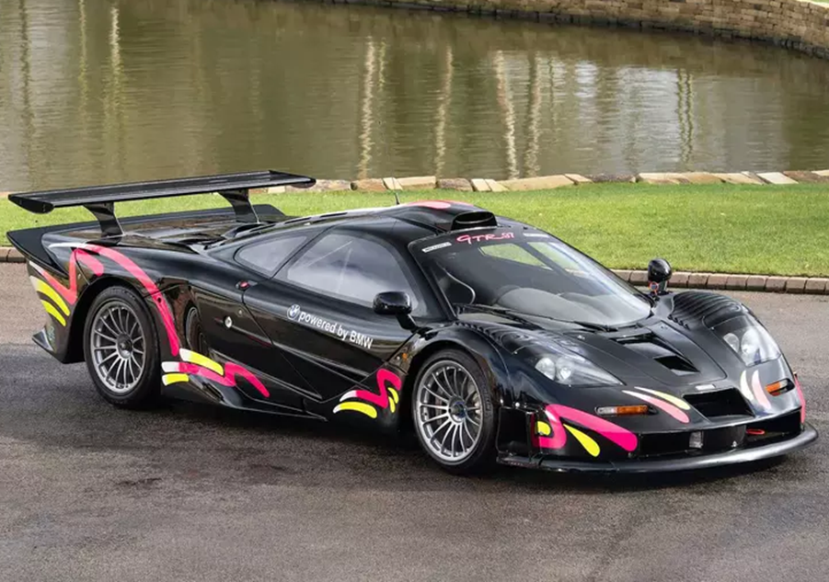
McLaren F1 GTR
Троицкий авиационный технический колледж ГА
Выполнил: Чернявский О.В.
Троицк 2020

Slide 2
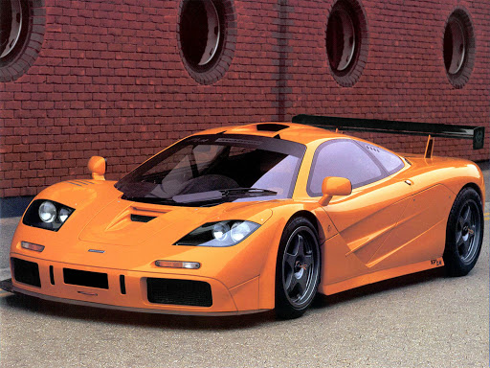
The creation history
McLaren F1 GTR
The McLaren F1 is a sports car designed and manufactured by British automobile manufacturer McLaren Cars, and powered by the BMW S70/2 V12 engine. The original concept was conceived by Gordon Murray. Murray was able to convince Ron Dennis to back the project. He engaged Peter Stevens to design the exterior and interior of the car. On 31 March 1998, the XP5 prototype with a modified rev limiter set the Guinness World Record for the world's fastest production car, reaching 240.1 mph (386.4 km/h), surpassing the modified Jaguar XJ220's 217.1 mph (349 km/h) record from 1992.

Slide 3
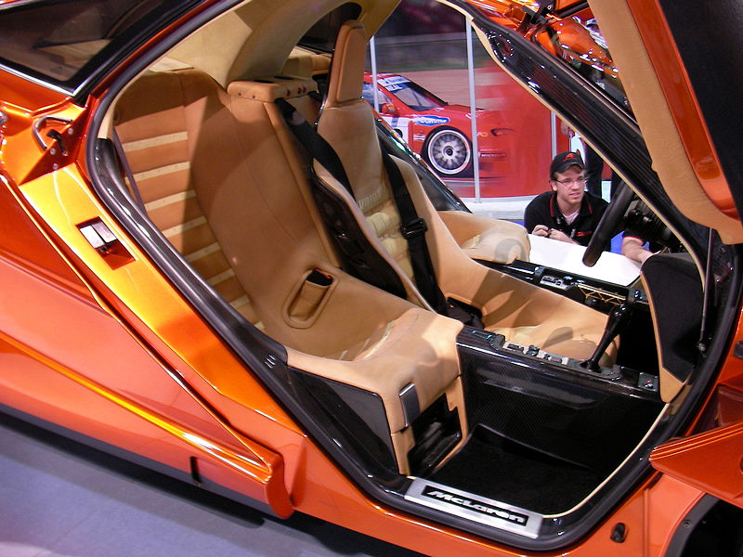
Design and implementation
The cabin of McLaren F1 GTR
Can accommodate three people
Chief engineer Gordon Murray's design concept was a common one among designers of high-performance cars: low weight and high power. This was achieved through use of high-tech and expensive materials such as carbon fibre, titanium, gold, magnesium and kevlar. The F1 was one of the first production cars to use a carbon-fibre monocoque chassis. Gordon Murray had been thinking of a three-seat sports car since his youth. When Murray was waiting for a flight home from the Italian Grand Prix in 1988, he drew a sketch of a three-seater sports car and proposed it to Ron Dennis. He pitched the idea of creating the ultimate road car, a concept that would be heavily influenced by the company's Formula One experience and technology and thus reflect that skill and knowledge through the McLaren F1.

Slide 4
A little about grammar
The F1 was one of the first production cars to use a carbon-fibre monocoque chassis.
В данном предложении описано свойство с помощью глагола “to be”, форма которого “Was” обозначает прошедшее время и единственное число подлежащего.
He engaged Peter Stevens to design the exterior and interior of the car.
В данном предложении описано действие в прошедшем времени, что показывает окончание “ed” у сказуемого:
Engaged
It has an alluminium alloy block and heads
В данном предложении описано действие в настоящем времени, а окончание “s” у сказуемого показывает что подлежащее – «It» стоит в 3-м лице единственного числа.

Slide 5
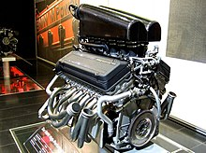
Engine
Specifications
Gordon Murray then approached BMW, which took an interest, and the motorsport division BMW M headed by engine expert Paul Rosche designed and built Murray a 6,064 cc (6.1 L; 370.0 cu in) 60º V12 engine called the BMW S70/2. At 461 kW (618 hp; 627 PS) and 266 kg (586 lb) the BMW engine ended up 14% more powerful and 16 kg (35 lb) heavier than Gordon Murray's original specifications, with the same block length.
It has an aluminium alloy block and heads, with bore x stroke of 86 mm × 87 mm (3.39 in × 3.43 in) DOHC with variable valve timing (a relatively new and unproven technology for the time) for maximum flexibility of control over the 4 valves per cylinder, and a chain drive for the camshafts.

Slide 6
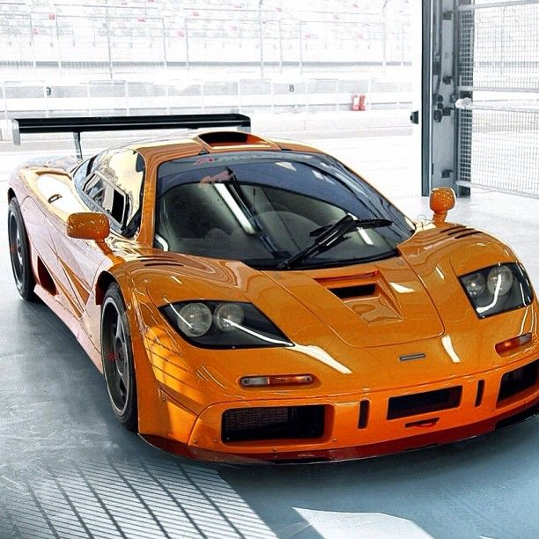
independent work
Задание:
- в каком времени и какой временной группе построены эти предложения
- составить отрицательные и вопросительные формы из данных предложений в своих тетрадях.
1. Gordon Murray then approached BMW.
2. It has an aluminium alloy block and heads, with bore x stroke of 86 mm × 87 mm.
3. May be some day the McLaren company will power its car with more 2000 hp engine.

Slide 7
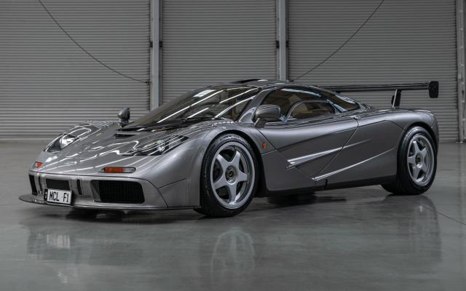
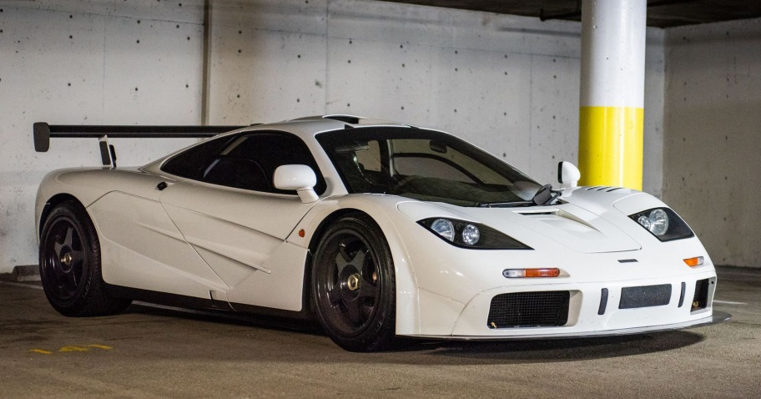
Aerodynamics
The standard McLaren F1 features no wings to produce downforce (compare the LM and GTR editions); however, the overall design of the underbody of the McLaren F1 in addition to a rear diffuser exploits ground effect to improve downforce which is increased through the use of two electric Kevlar fans to further decrease the pressure under the car. A "high downforce mode" can be turned on and off by the driver. At the top of the vehicle, there is an air intake to direct high pressure air to the engine with a low pressure exit point at the top of the very rear. Under each door is a small air intake to provide cooling for the oil tank and some of the electronics. The airflow created by the electric fans not only increases downforce, but the airflow that is created is further exploited through design, by being directed through the engine bay to provide additional cooling for the engine and the ECU. At the front, there are ducts assisted by a Kevlar electric suction fan for cooling of the front brakes.

Slide 8
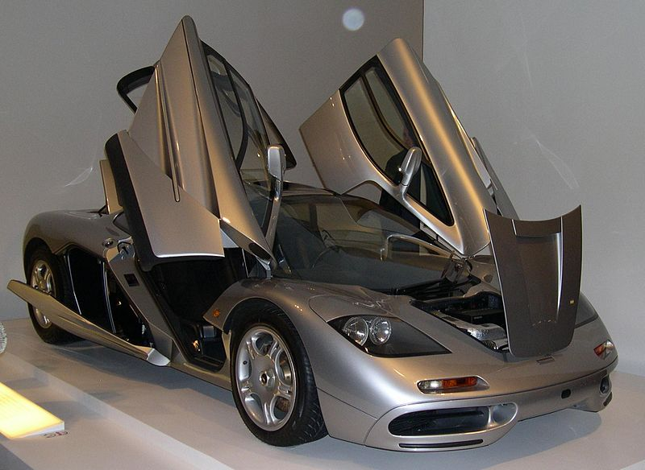
Chassis and body
Перевести на английский:
McLaren F1 был ранним примером серийного дорожного автомобиля, в котором использовалась цельная конструкция шасси из монокока из армированного углеродным волокном полимера.
Aluminium and magnesium were used for attachment points for the suspension system, inserted directly into the CFRP.
The car features a central driving position – the driver's seat is located in the middle, ahead of the fuel tank and ahead of the engine, with a passenger seat slightly behind and on each side. The doors on the vehicle move up and out when opened, and are thus of the butterfly type, also called Dihedral doors. Gordon Murray's design for the doors was inspired by a Toyota Sera.

Slide 9
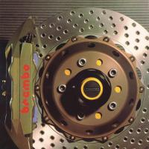
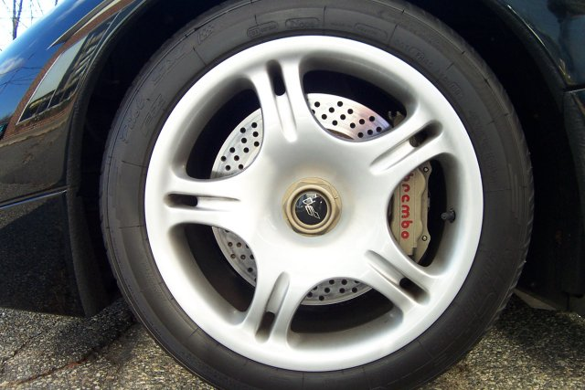
Brakes
The F1 features unassisted, vented and cross-drilled brake discs made by Brembo. Front size is 332 mm (13.1 in) and at the rear 305 mm (12.0 in). The calipers are all four-pot, opposed piston types, and are made of aluminium. The rear brake calipers do not feature any handbrake functionality, however there is a mechanically actuated, fist-type calipers which is computer controlled and thus serves as a handbrake.
To increase caliper stiffness, the calipers are machined from a single solid piece of metal (in contrast to the more common being bolted together from two halves). Pedal travel is slightly over one inch. Activation of the rear spoiler will allow the air pressure generated at the back of the vehicle to force air into the cooling ducts located at either end of the spoiler which become uncovered upon application of it.

Slide 10
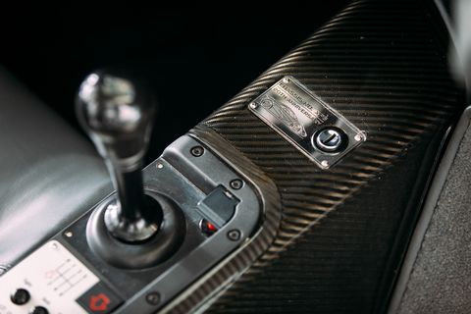
Gearbox and powertrain
The standard McLaren F1 has a transverse 6-speed manual gearbox with an AP carbon triple-plate clutch contained in an aluminium housing. The gearbox was developed in collaboration with Wiesmann transmissions in California. The second generation GTR edition has a magnesium housing. Both the standard edition and the 'McLaren F1 LM' have the following gear ratios: 3.23:1, 2.19:1, 1.71:1, 1.39:1, 1.16:1, 0.93:1, with a final drive of 2.37:1 x 1.28:1, the final gear is offset from the side of the clutch. The Torsen LSD (Limited Slip Differential) has a 40% lock.

Slide 11
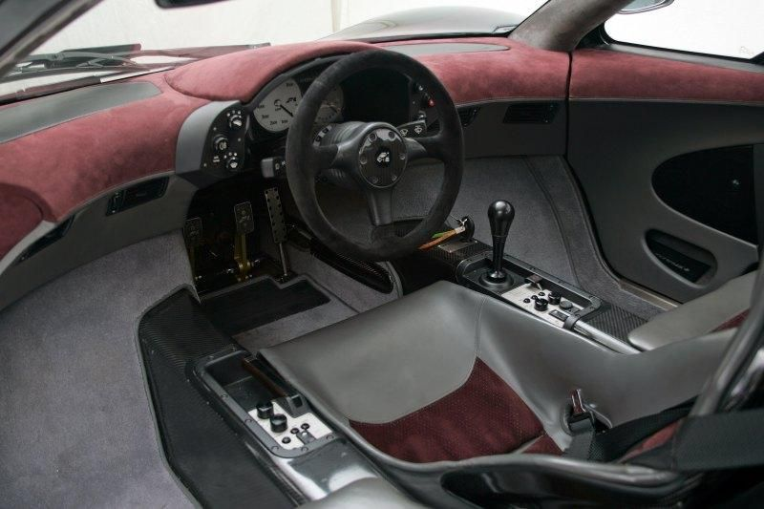
Interior and equipment
Standard equipment for the McLaren F1 includes full cabin air conditioning, a rarity on most sports cars and a system design which Murray again credited to the Honda NSX, a car he had owned and driven himself for 7 years without ever needing to change the AC automatic setting.Further comfort features included SeKurit electric defrost/demist windscreen and side glass, electric window lifts, remote central locking, Kenwood 10-disc CD stereo system, cabin access release for opening panels, cabin storage compartment, four-lamp high performance headlight system, rear fog and reversing lights, courtesy lights in all compartments, map reading lights and a gold-plated Facom titanium tool kit and first aid kit (both stored in the car).

Slide 12
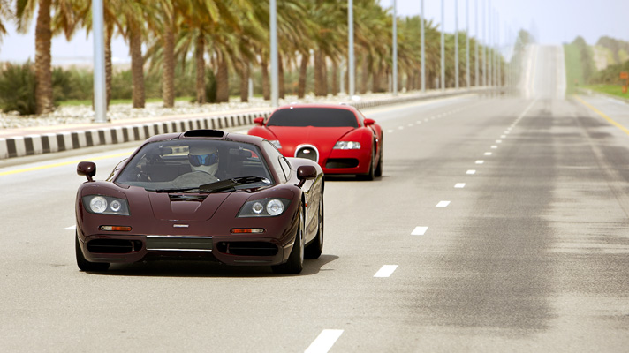
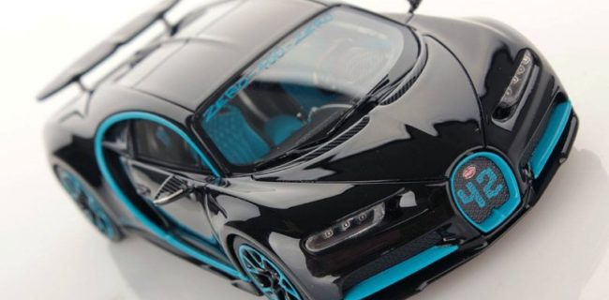
Performance
The F1 remains one of the fastest production cars ever made; as of October 2018 it is succeeded by very few cars, such as the Bugatti Veyron and the Bugatti Chiron. However, all of the higher top speed machines use forced induction to reach their respective top speeds, whereas the McLaren F1 is naturally aspirated.

Slide 13
Homework
Домашнее задание:
- повторить строение предложений в группе времён Simple, а также предложений с глаголом to be.
- составить по 5 предложений каждого типа.

Slide 14
Thanks for attention

